Slide 1



FALSE POSITION METHOD
(REGULA FALSI METHOD)
Presented By:
Sanzida Rokhsana Mim
241311118

Slide 2
01
INTRODUCTION
The False Position Method (also called Regula Falsi Method) is a bracketing method for finding roots of nonlinear equations.
It is similar to the Bisection Method, but instead of using the midpoint, it uses a point of intersection of the secant line between two points.
Purpose: To find the approximate root of an equation f(x)=0.
False Position Method

Slide 3
02
BASIC CONCEPT
01
Start with two initial guesses, a and b, such that
f(a)×f(b)<0
→ means the root lies between a and b.
02
Draw a secant line joining the points (a,f(a)) and (b,f(b)).
03
The point where this line crosses the x-axis gives a new approximation of the root.

Slide 4
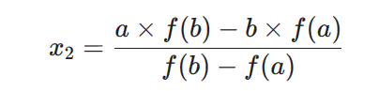

03
FORMULA
The formula for finding the new approximation (x₂) is:
After that:
If f(a)×f(x2)<0, then root lies between a and x2 → set b=x2​.
Else → set a=x2.
Repeat until the result is accurate enough.

Slide 5
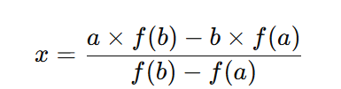
04
Algorithm
Input: Function f(x), two initial guesses a and b, tolerance ϵ\epsilonϵ.
Check: f(a)×f(b)<0 (root lies between a and b).
Compute:
If ∣f(x)∣ < ϵ, then stop; x is the root.
If f(a)×f(x)<0, set b=x; else set a=x.
Repeat steps 3–5 until convergence.

Slide 6
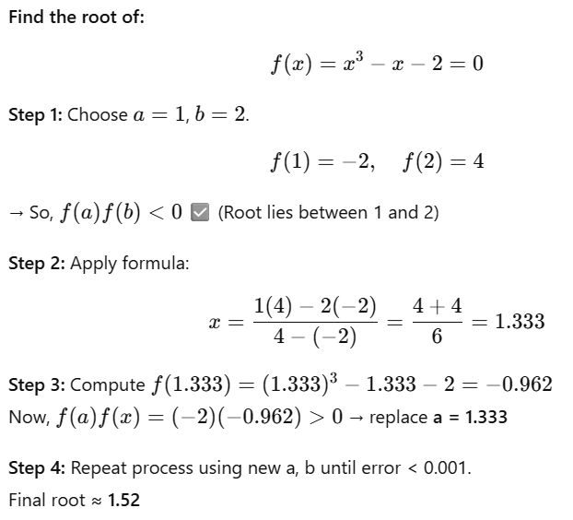
05
Example Problem

Slide 7
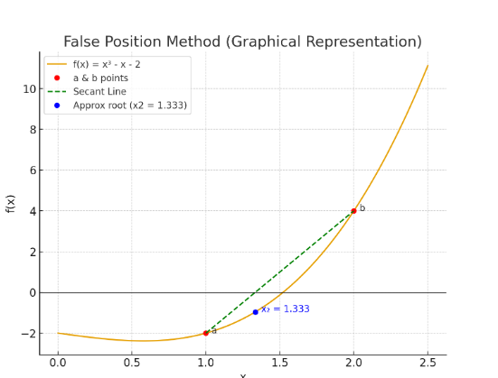
06
Graphical Representation
graph of f(x)=x3−x−2.
Mark points (a, f(a)) and (b, f(b)).
secant line intersecting x-axis at new point x2​.

Slide 8
07
Advantages & Disadvantages
Faster than the Bisection
Method.
Sometimes converges
slowly if the function is
not well-behaved.
Always converges if
𝑓(𝑎)𝑓(𝑏)<0.
Repeated endpoints may
cause slow convergence.
Simple and easy to
implement.

Slide 9
08
Applications
Solving nonlinear equations in engineering, physics, and computer science.
Used in root finding when derivative is not known.
Often used as a starting point for other methods (like Newton-Raphson).
Applications &Conclusion
Conclusion
False Position Method is an iterative and bracketing technique for root finding.
Provides a better approximation than Bisection Method.
Works well when initial guesses are close to the real root.
Final Root Example: ≈ 1.52 for x^3 - x - 2 =0

Slide 10
THANK YOU
False Position Method

